Slide 1

Receipt Keeper
Receipt Management Application
Changho Choi
Hassan Nahhal
Nicholas Collins
SungJoe Kim
Mobile Solutions Development

Slide 2
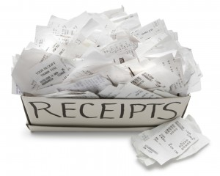
Introduction
Be familiar with spending
Avoid impulse buying
Manage your money
Save you time & effort
Here’s the way …
Notes:
Sequence
Introduction / Agenda : Hassan
Problem/Solution : Nick
Tech. : Chang
Mobile Features : Hassan
Web Features : Joe
Plan/Conclusion :Nick
Introduction : Hassan will prepare expression and proper images

Slide 3

Agenda
Problem
Solution
Technologies
Methodologies
Features (Mobile)
Features (Web)
Future plan
Conclusion
Notes:
What’s it (This slide is not necessary)

Slide 4



Problem
Forget stuff bought
Tracking all of this is a handful
Strict budget
Alternative is not ultimate
A long process to start using it
Offer limited functions
Focused on private, personal use
Notes:
Here’s Nick

Slide 5




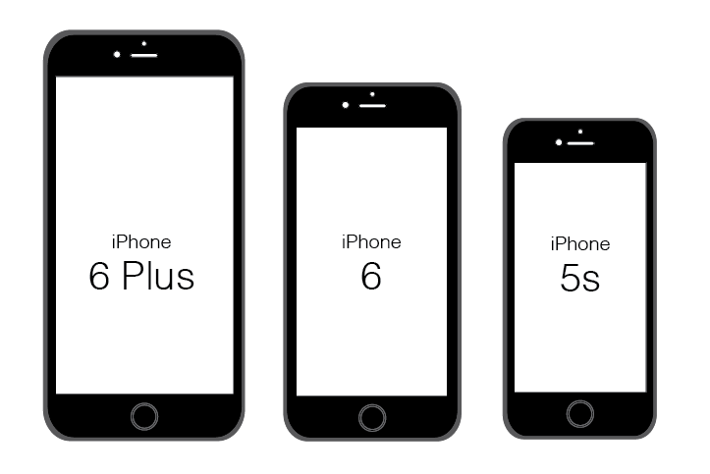


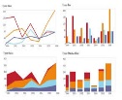
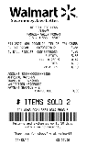
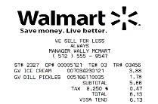
Our Solution
Quick & easy access to start
No extra devices required
Scan receipt & store it Online
Filter, Search for receipts, export as files
Generate charts, reports feedback
Support working in groups

Slide 6






Work Process
Scan
receipt
Output
data
Save in
database
Track
expenses
View
anywhere
Notes:
From here, Chang

Slide 7





















Technologies

Slide 8
Methodologies
Development & Team Rules
Agile Unified Process with 2 week iteration
Coding Standards to follow
Source Control & Change Management
3 GitHub repositories
Master and branching out from dev_prod
Wiki to keep track of outcome
Issues tracking to assign fixes or tasks
Communication
Slack and regular meetings
Notes:
Use Icon to explain above text descriptions
Modify and improve from Chang and add proper images

Slide 9
Technical Diagrams
User
Receipt
File
1
*
1
*
0..
*
0..
Store
<<belongs to>>
<<belongs to>>
*
0..
Group
Tag
*
0..
*
0..
<<belongs to>>
Category
Notification
Details

Slide 10

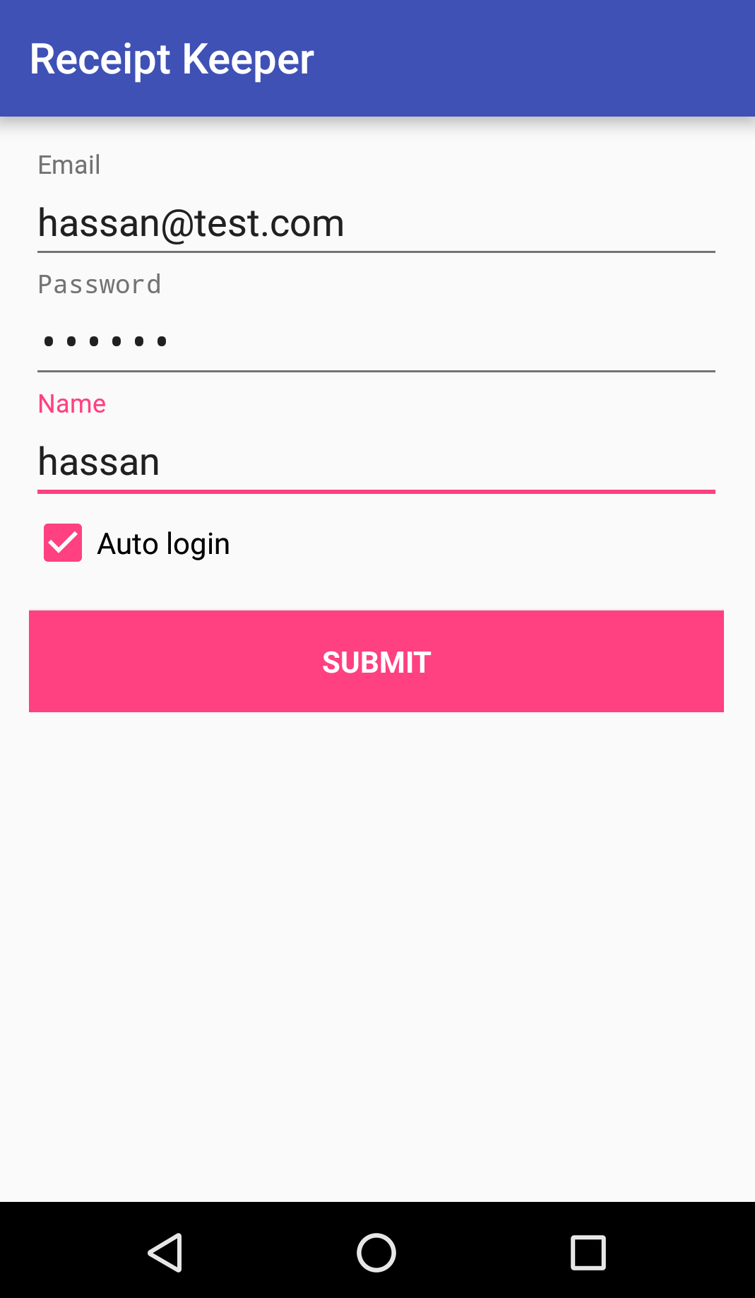
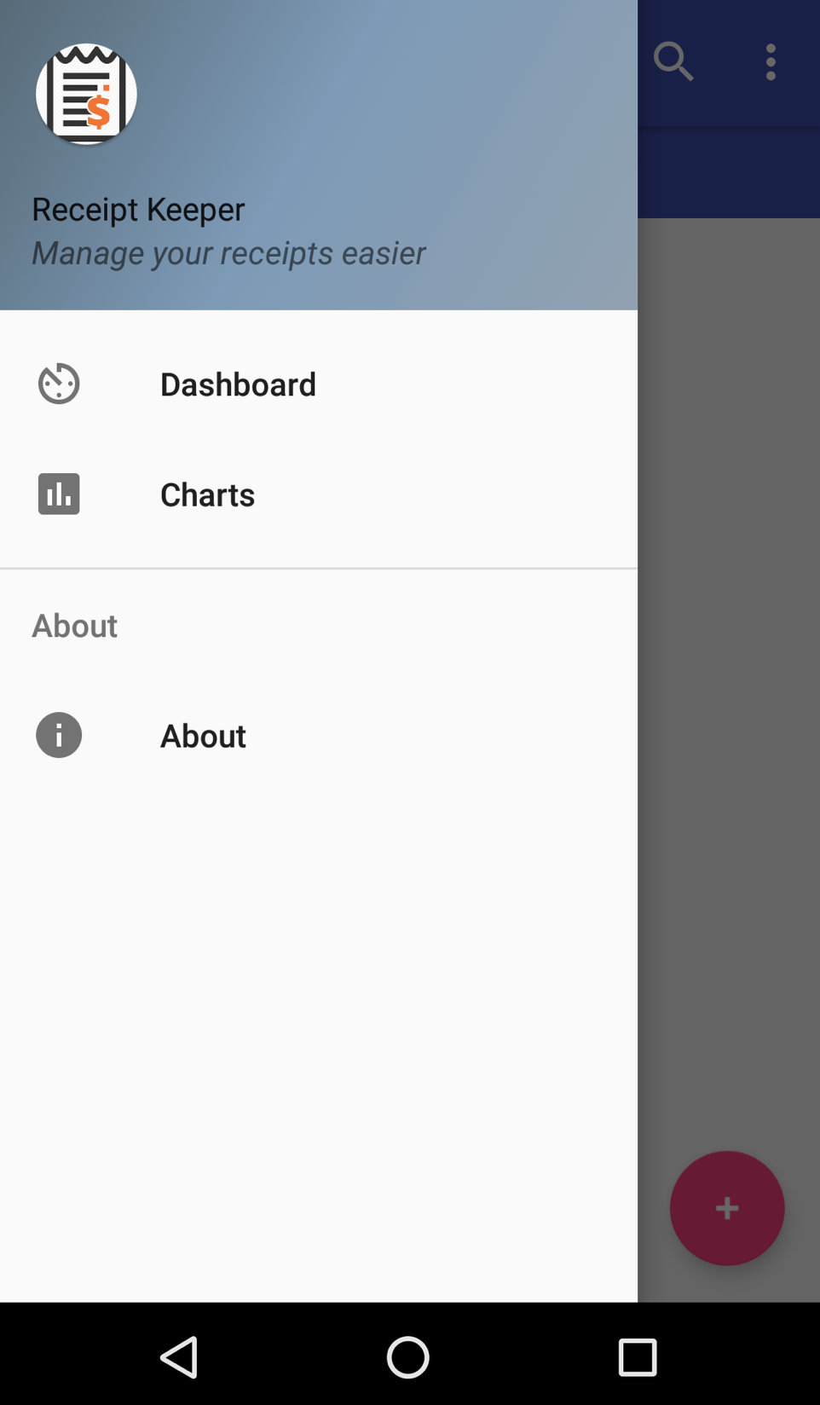
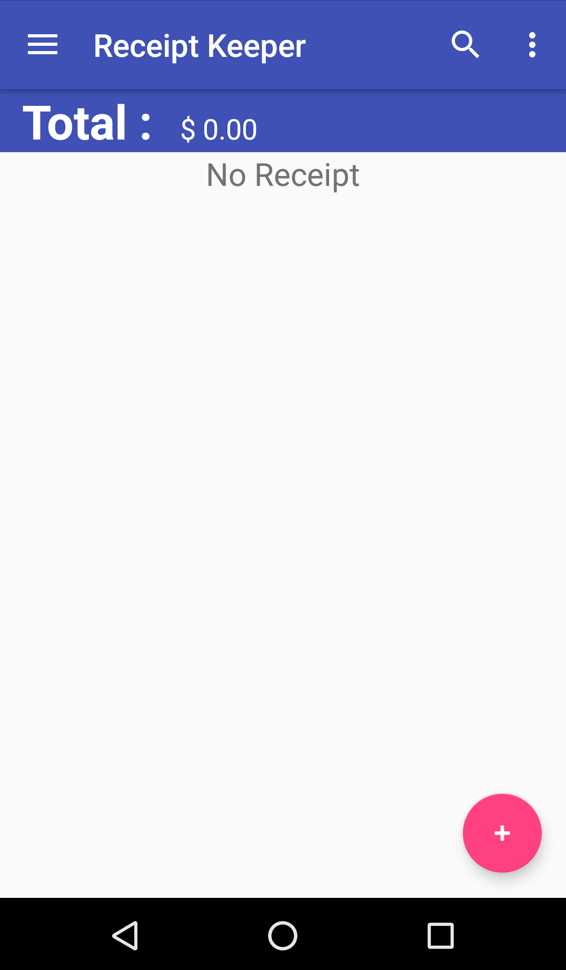
Features (screenshots)
Sliding view
Main Page
Sign in/up
Notes:
From here : Hassan
Screenshots for major actions and short words

Slide 11
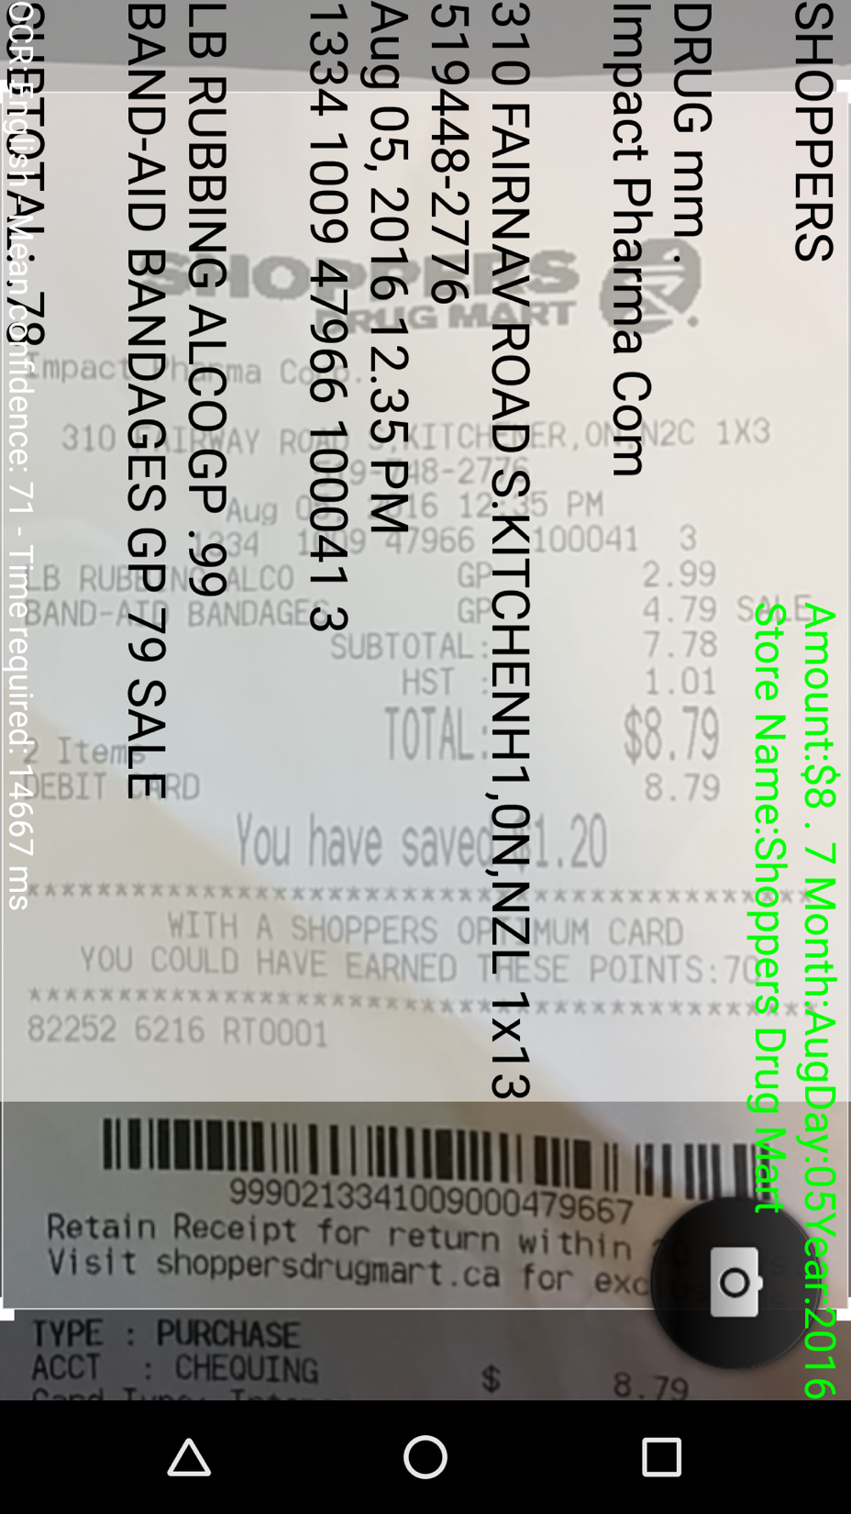
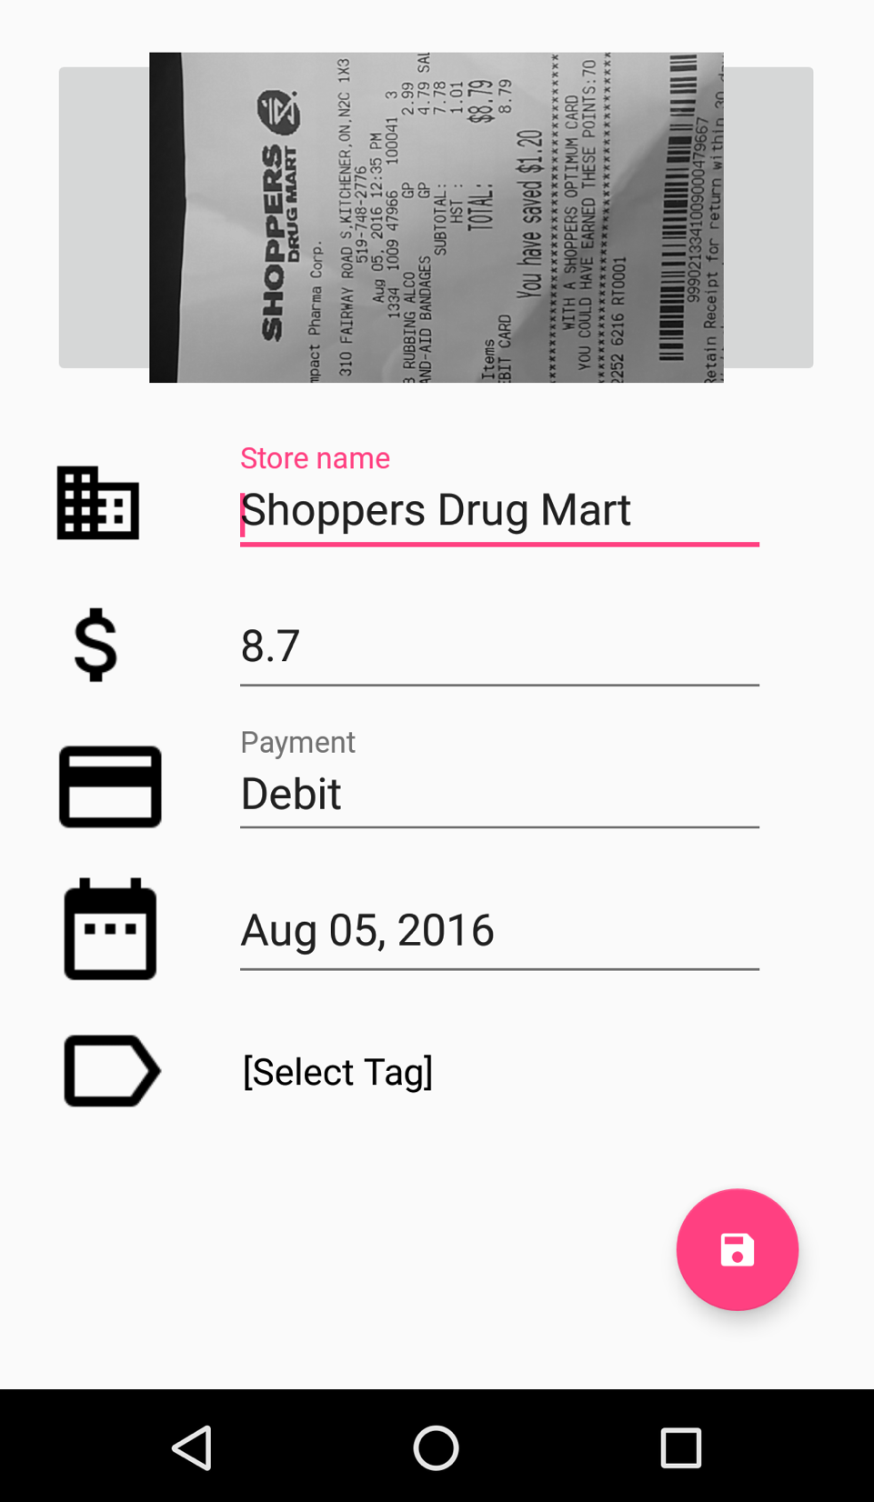
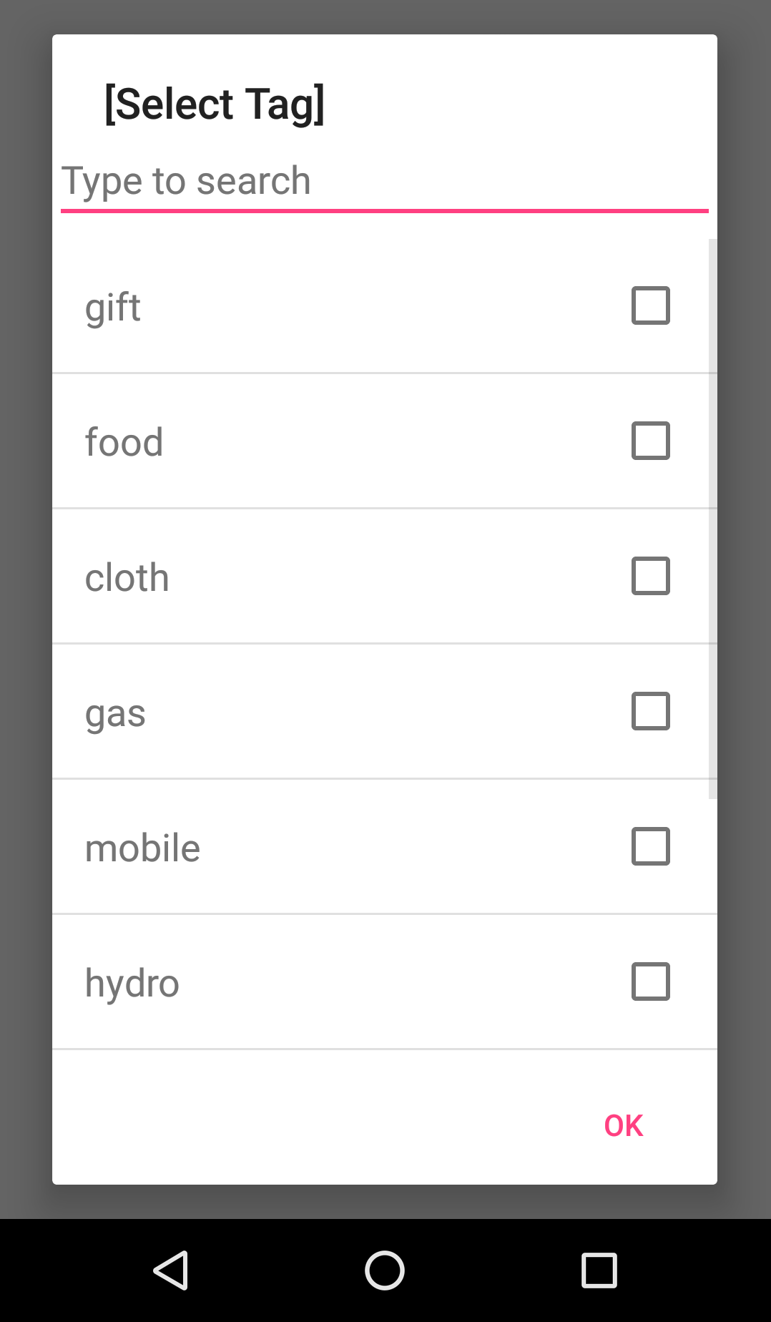
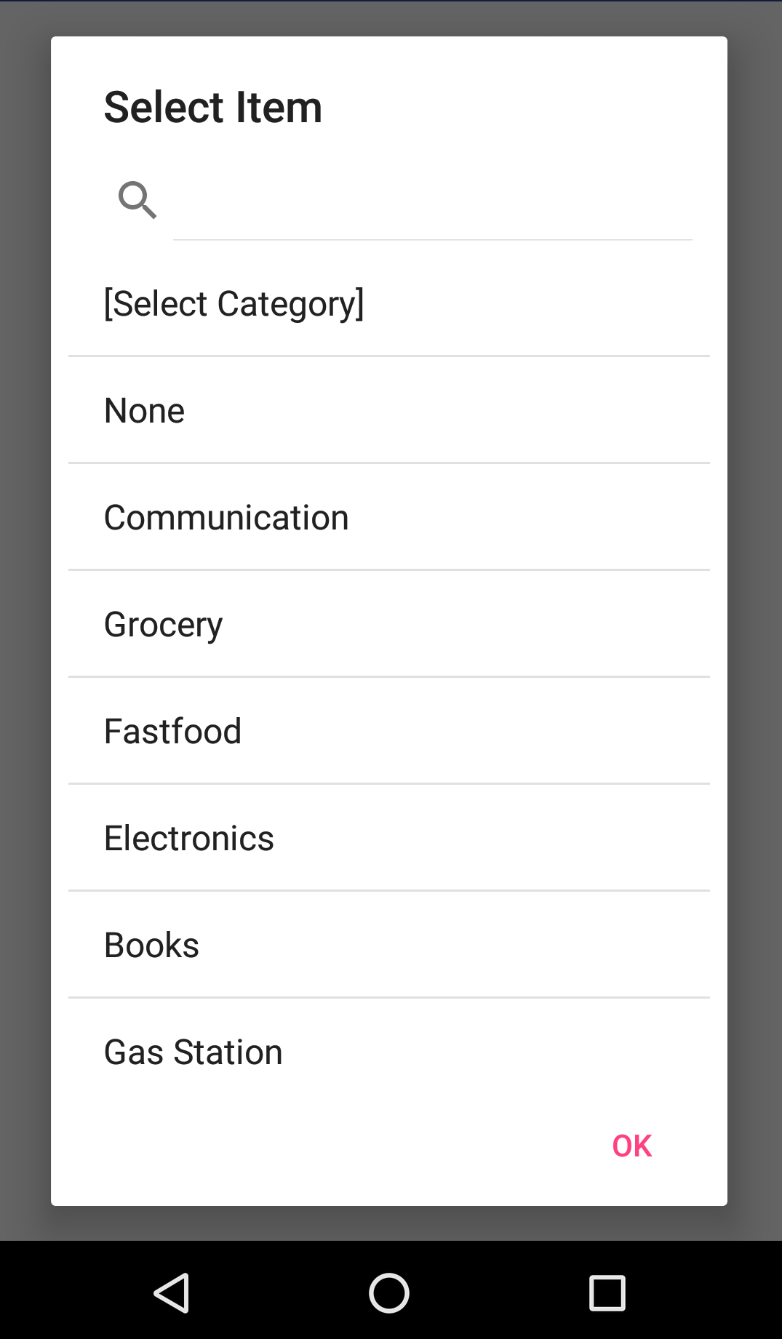
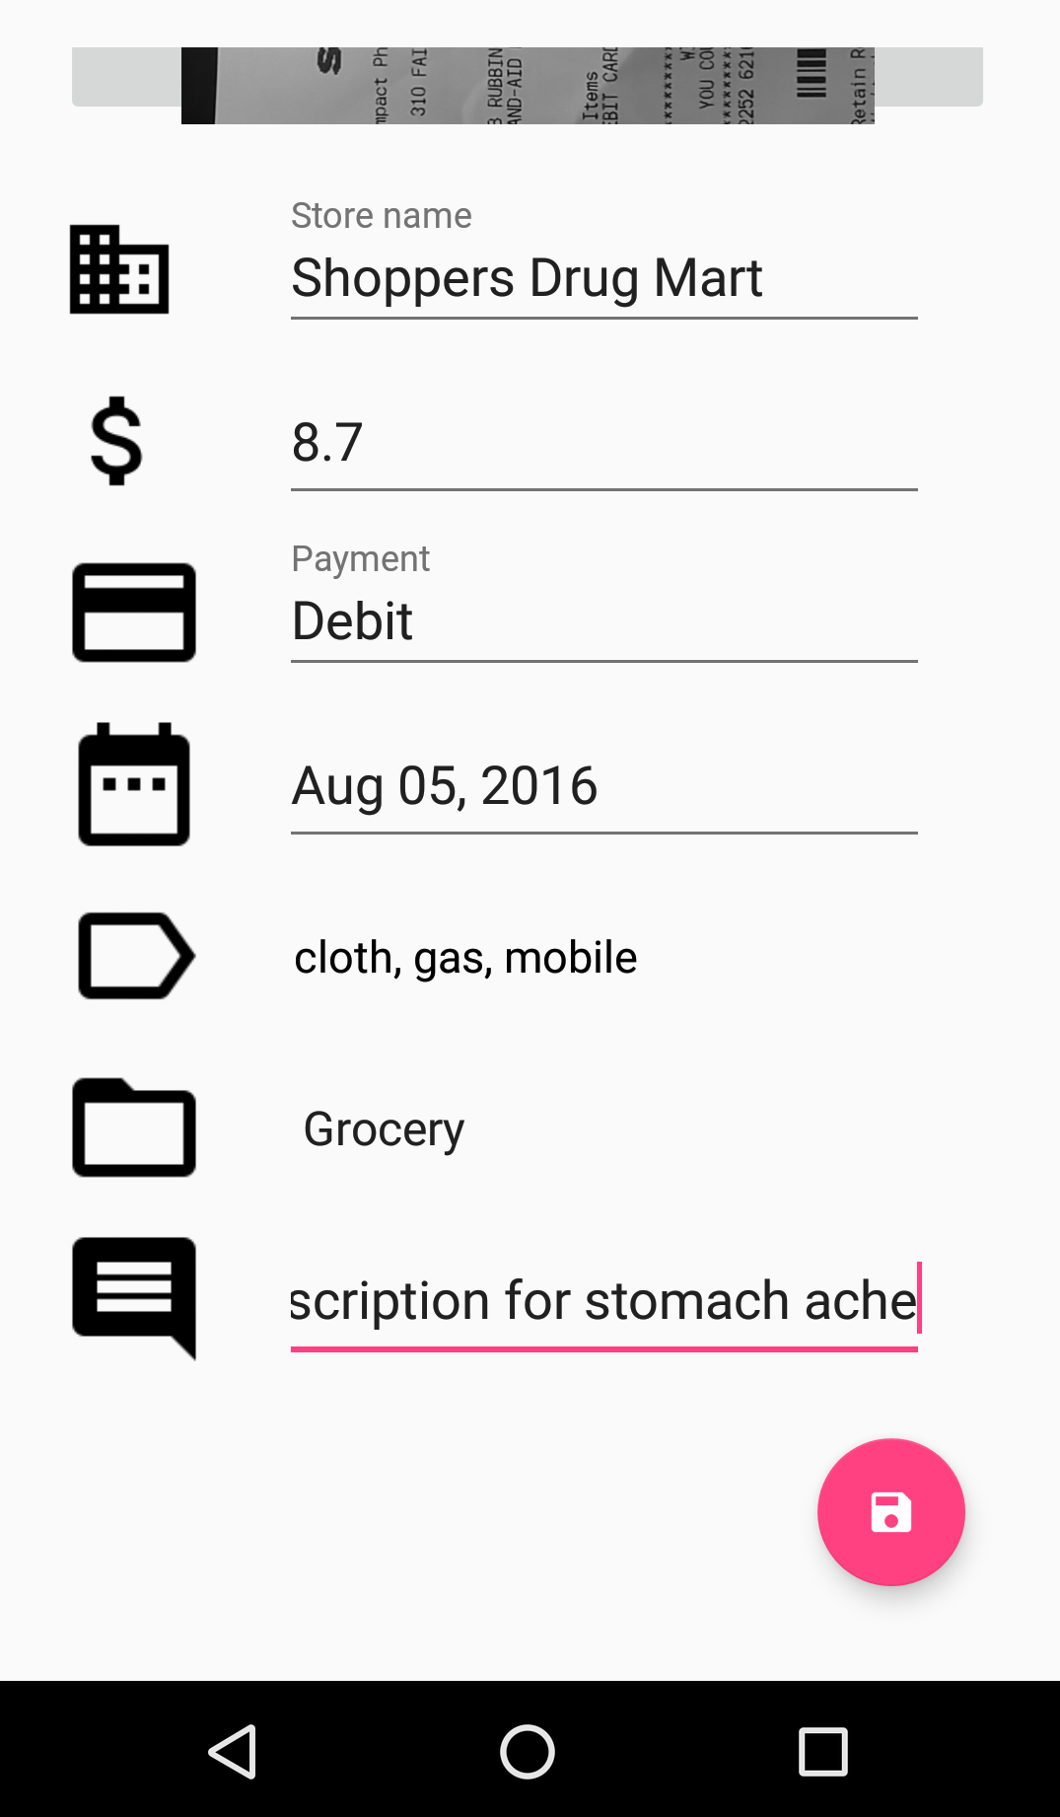
Features (screenshots)
Add tag
Select category
Save
Data gathered
OCR recognition

Slide 12
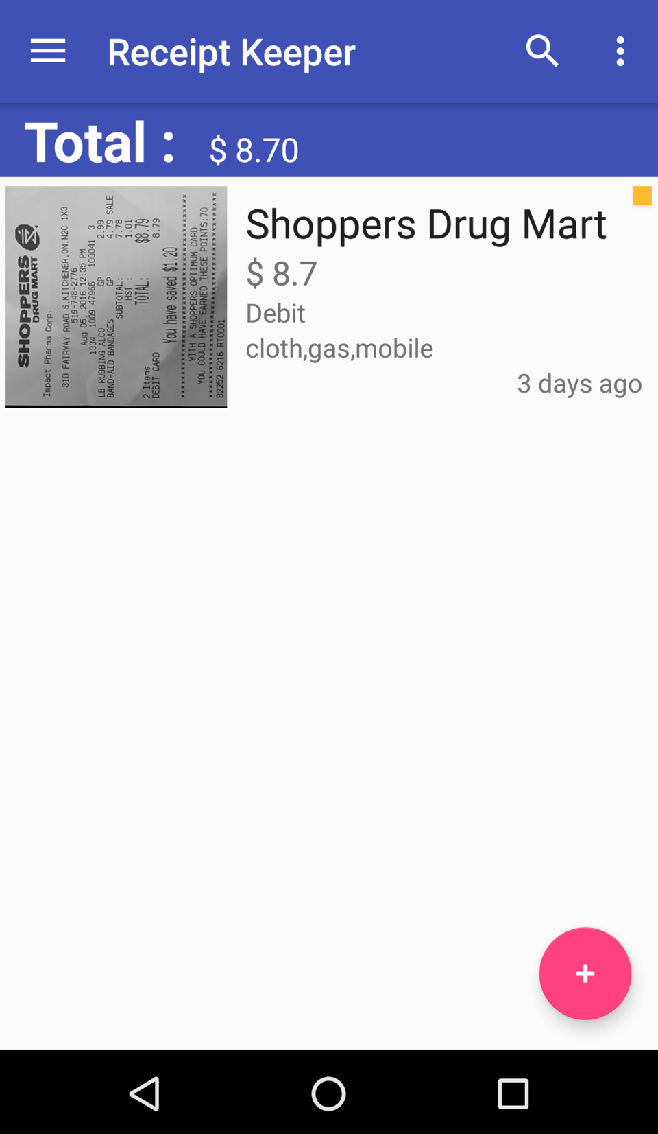
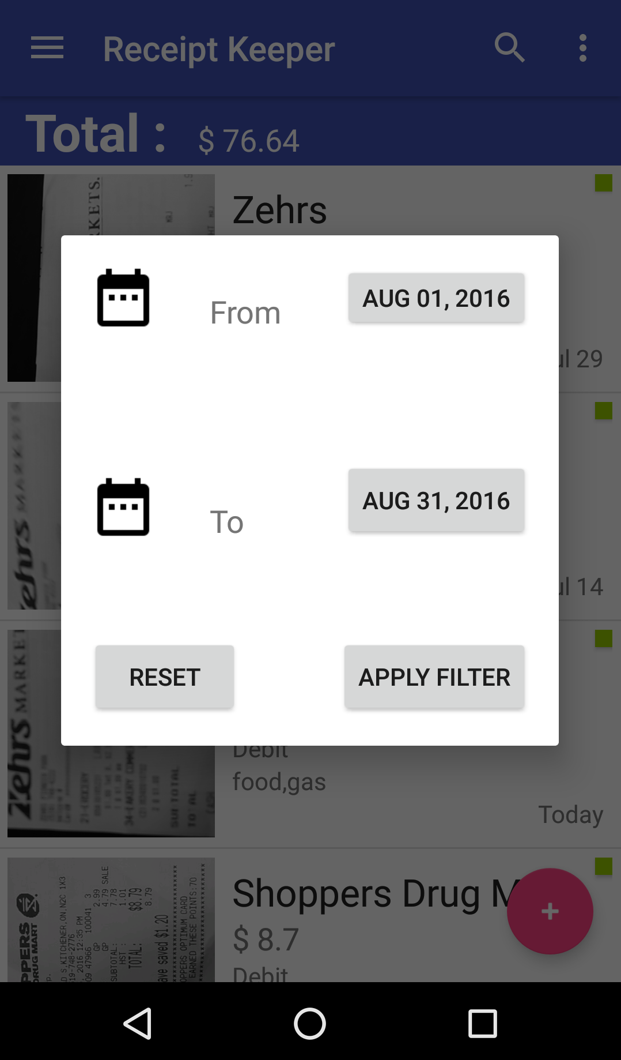
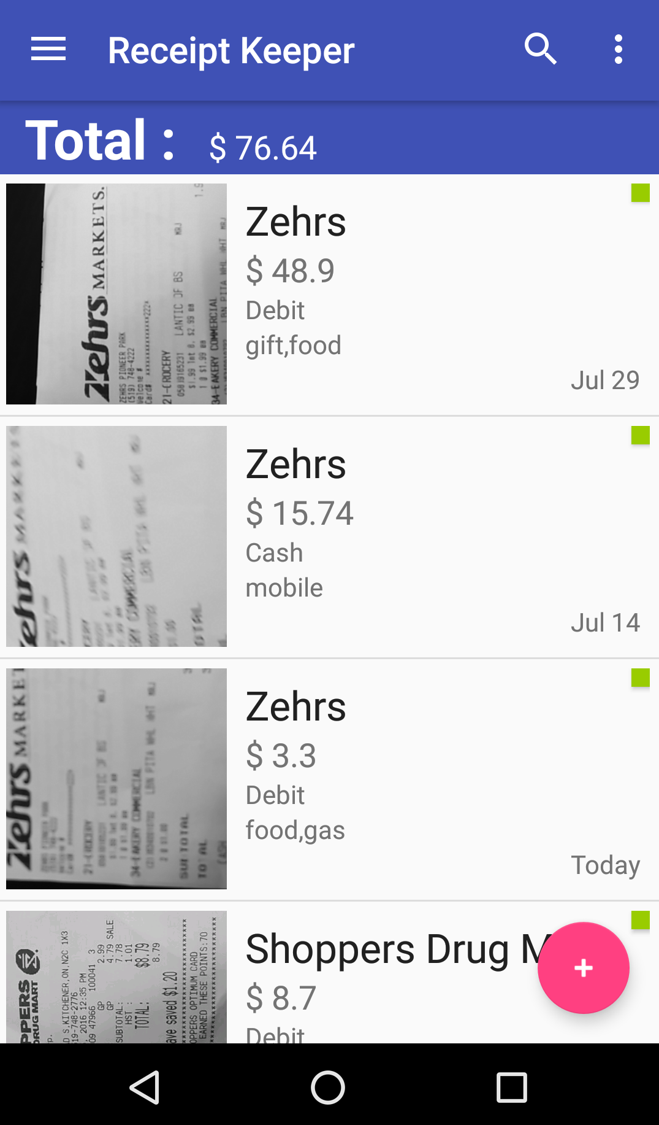
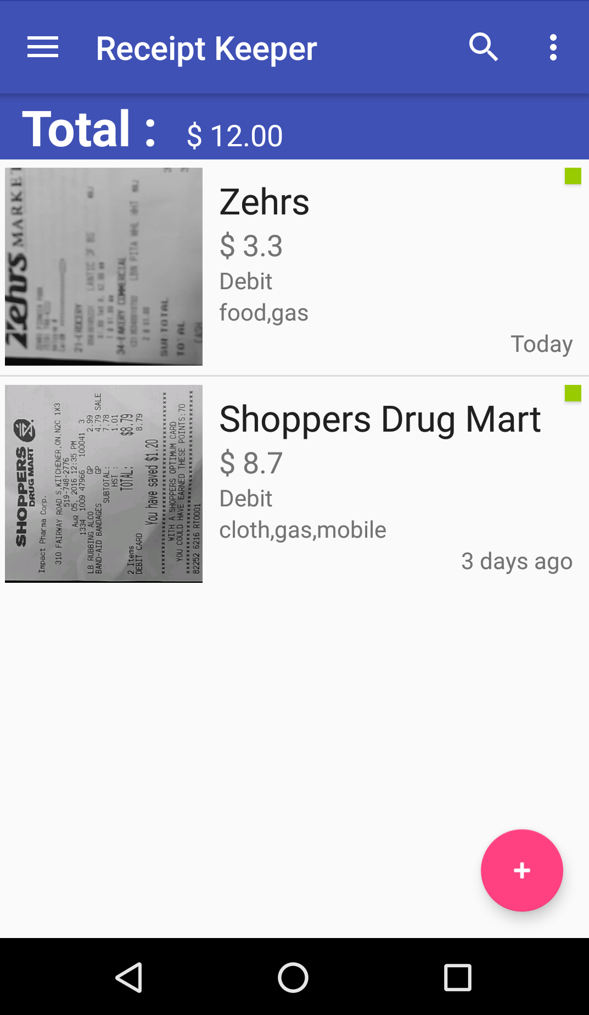
Features (screenshots)
Synced
Filter results
Receipts
Filter

Slide 13
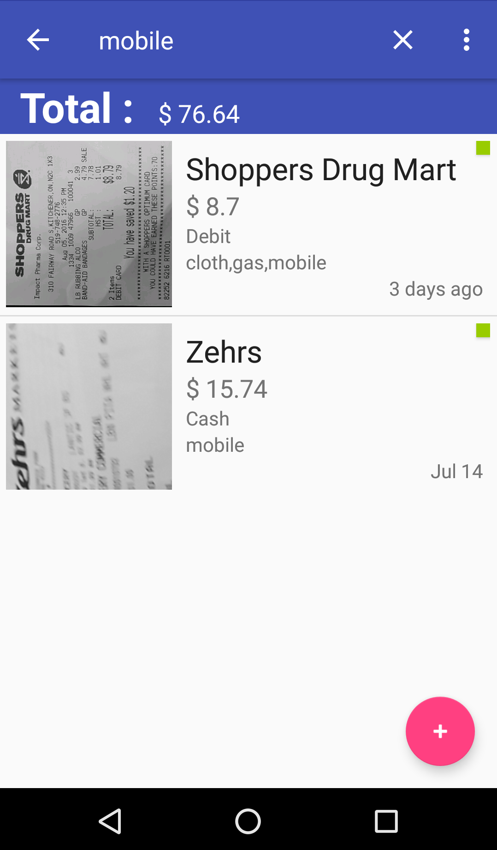
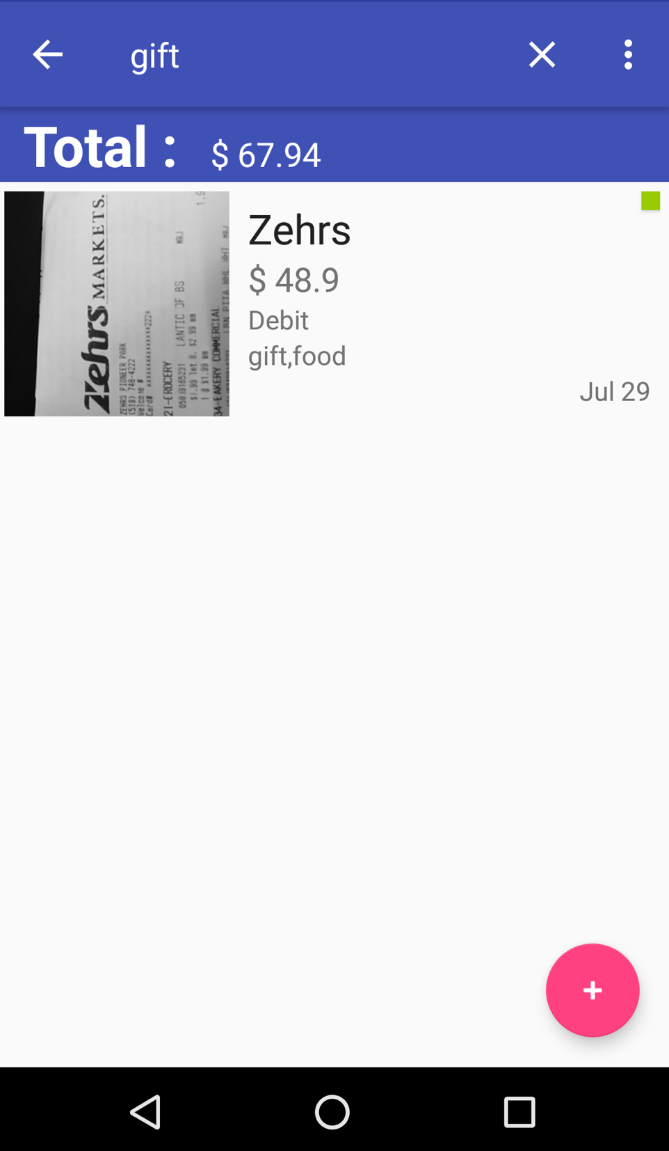
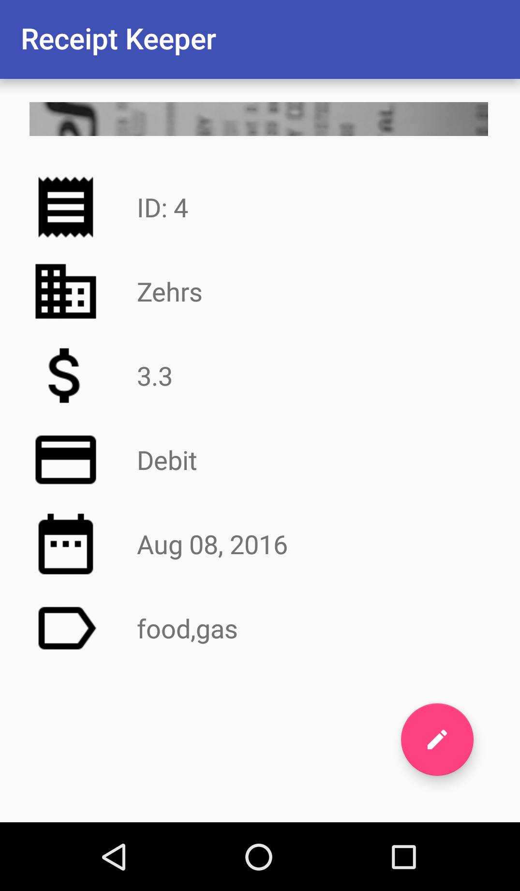
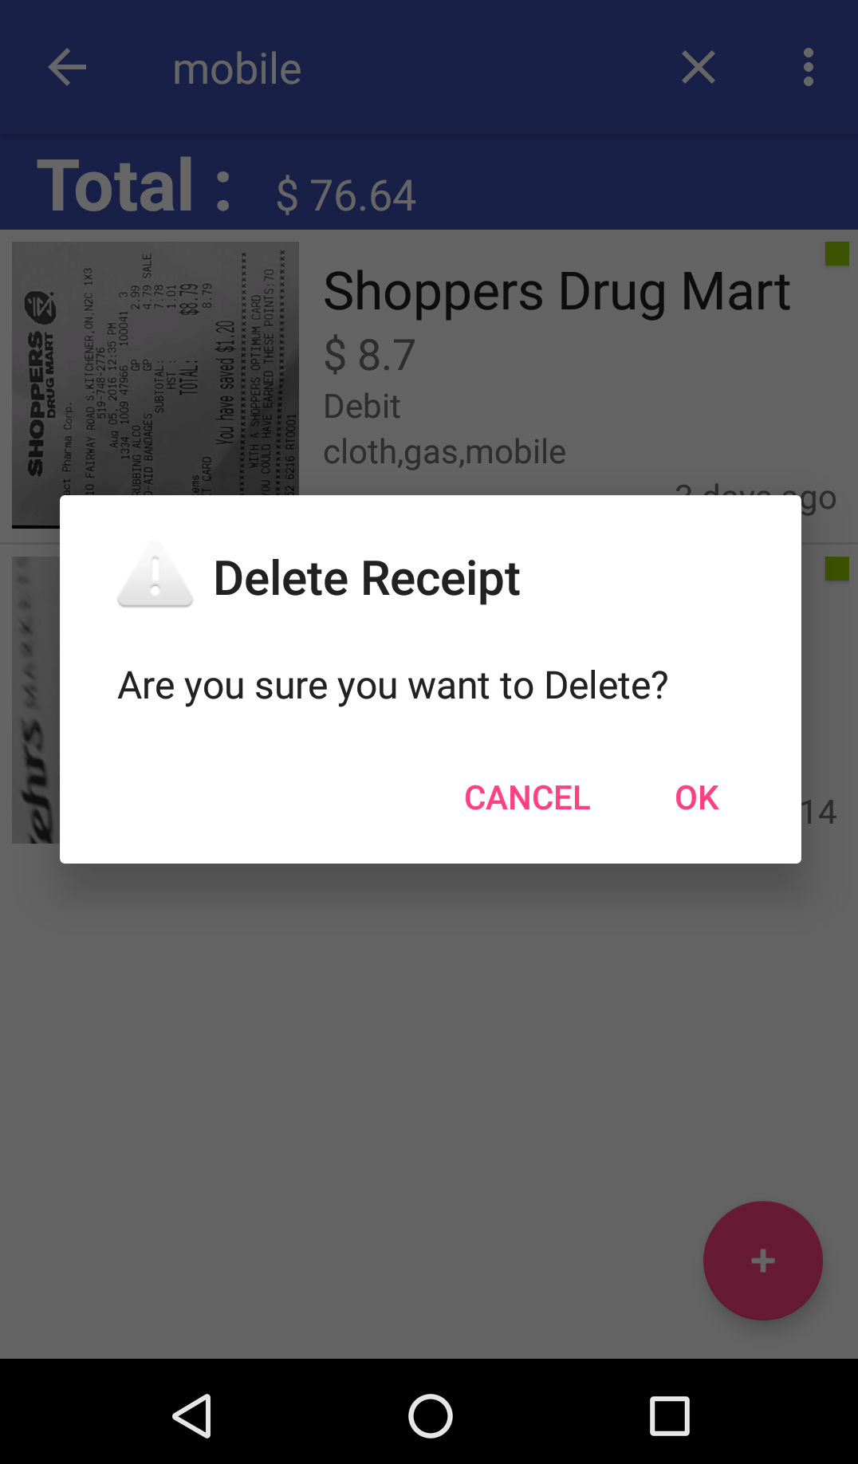
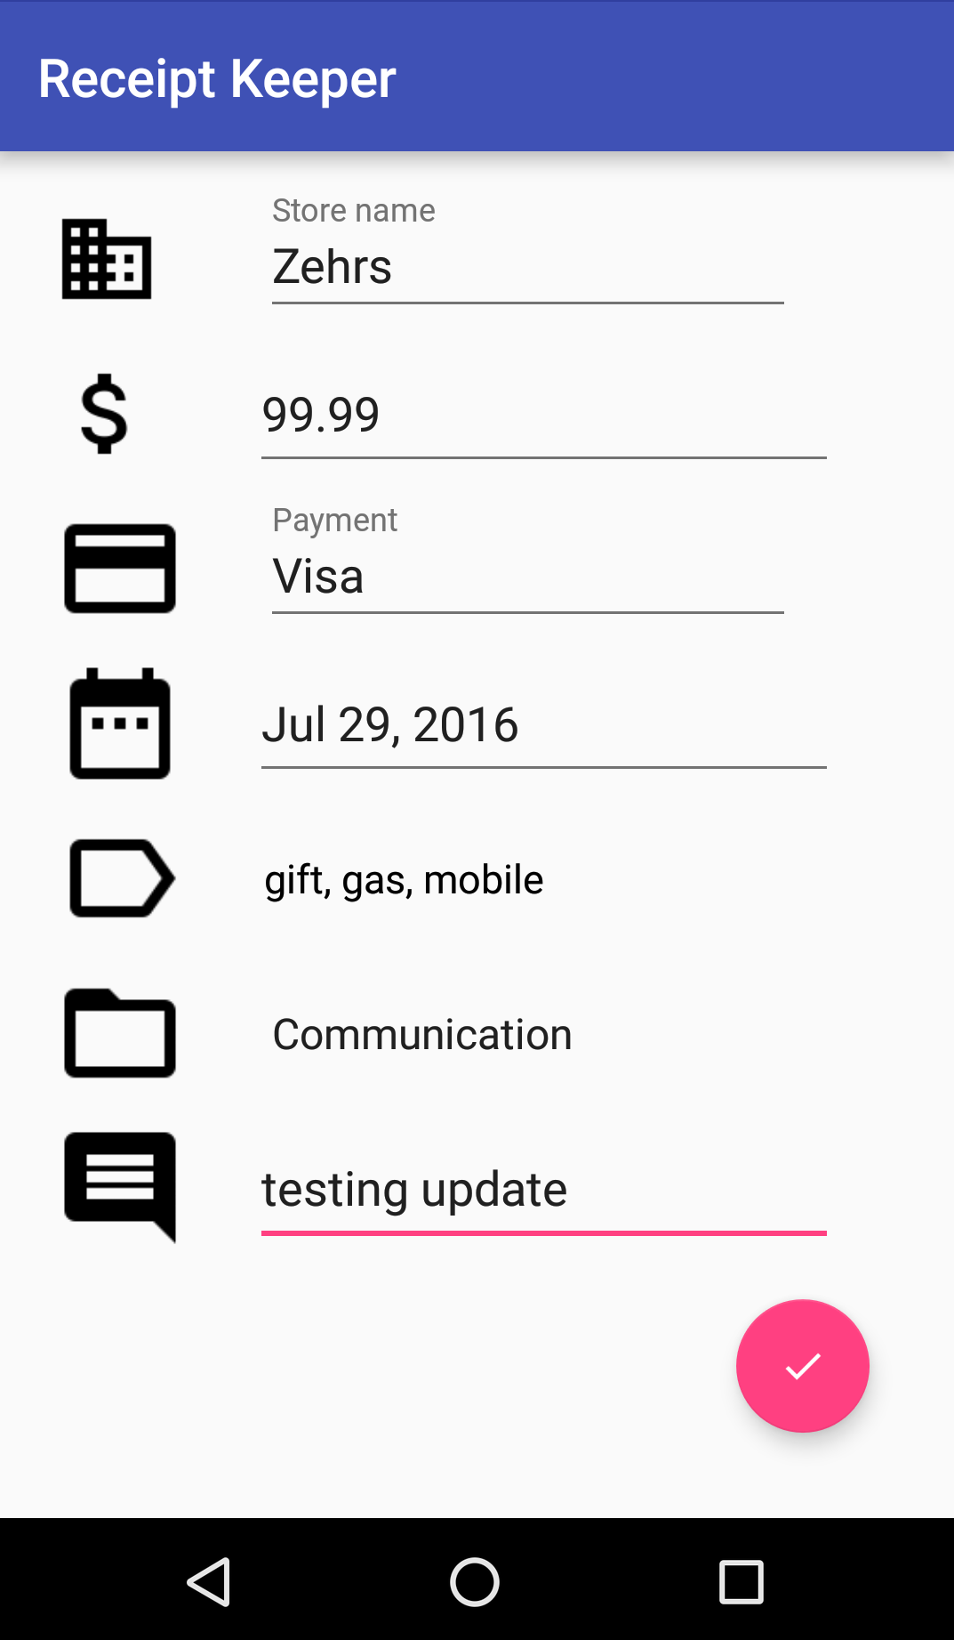
Features (screenshots)
View
Delete
Update
Long click
Click

Slide 14
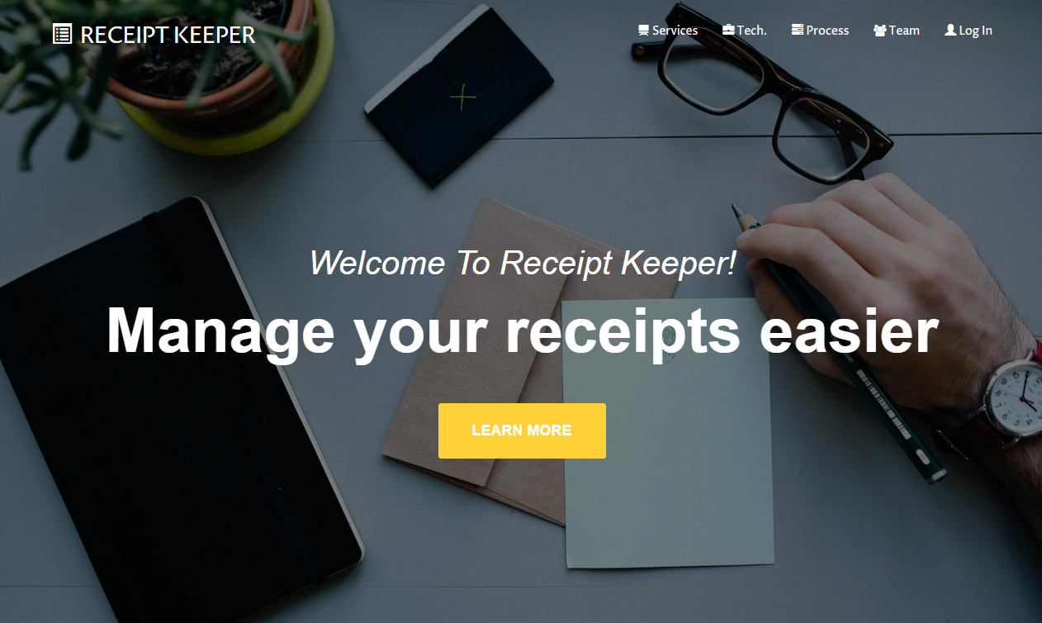
Features (screenshots)

Slide 15
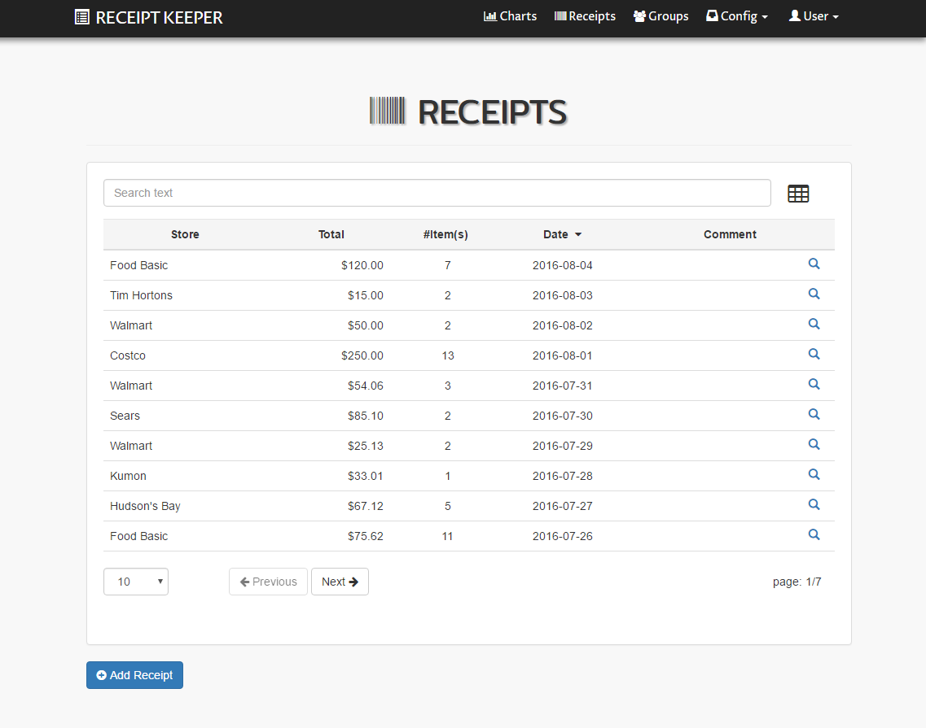
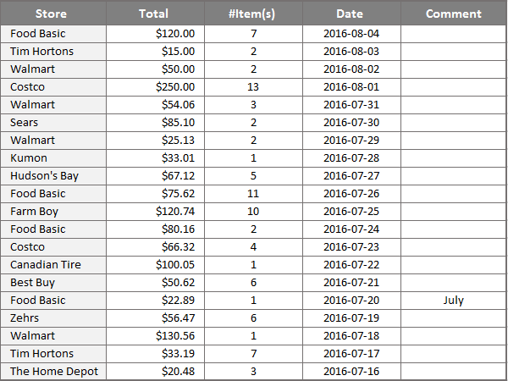
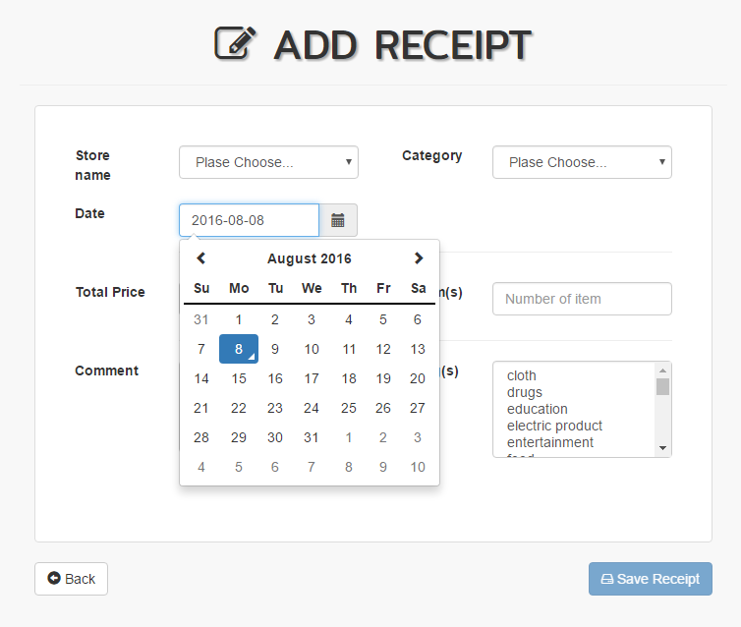
Features (screenshots)
Search/ Sort/ Pagination/ Excel Export

Slide 16
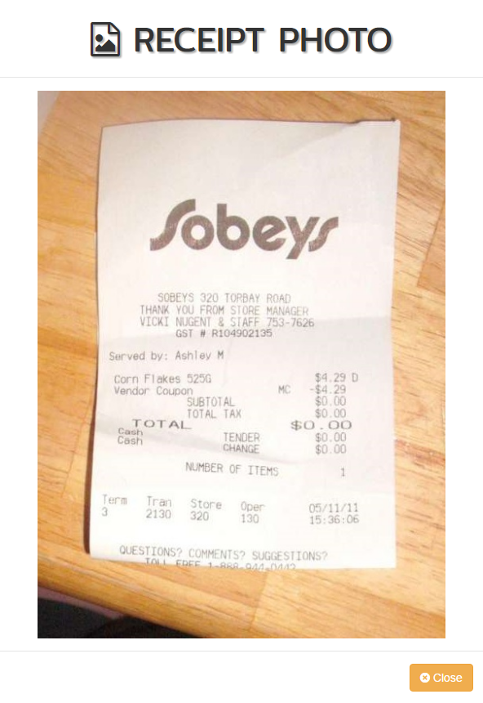
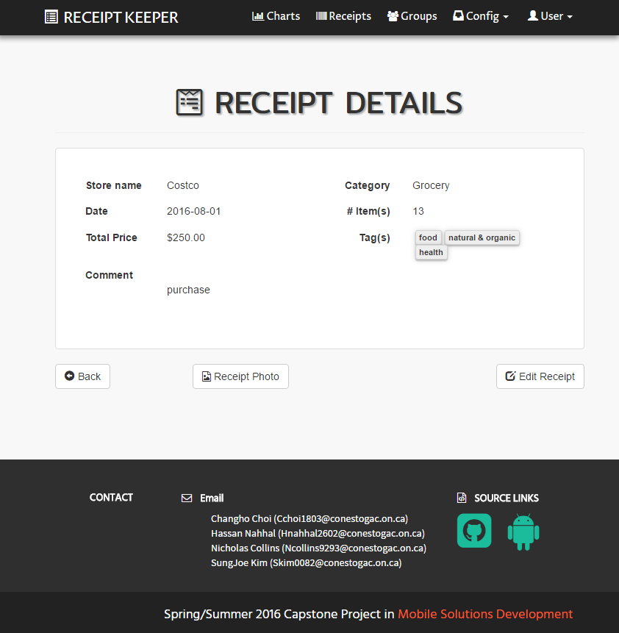
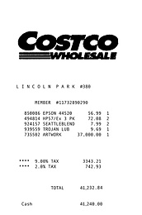
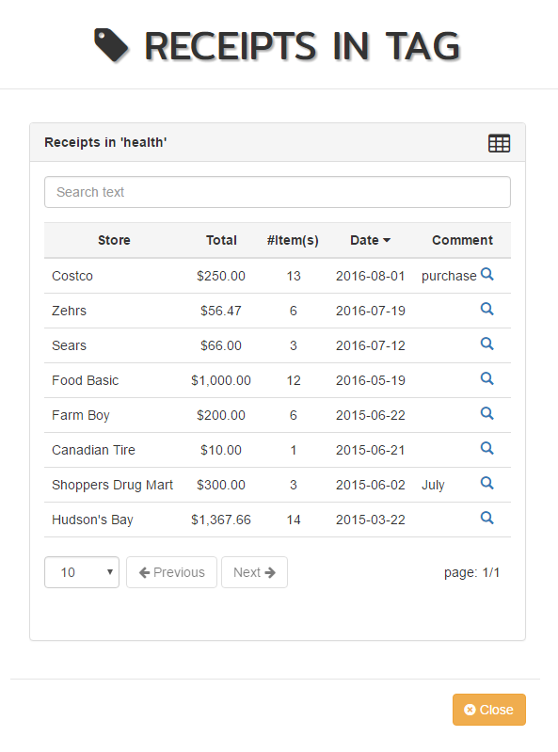


Features (screenshots)
Receipt photo/ Extract receipts from tag

Slide 17
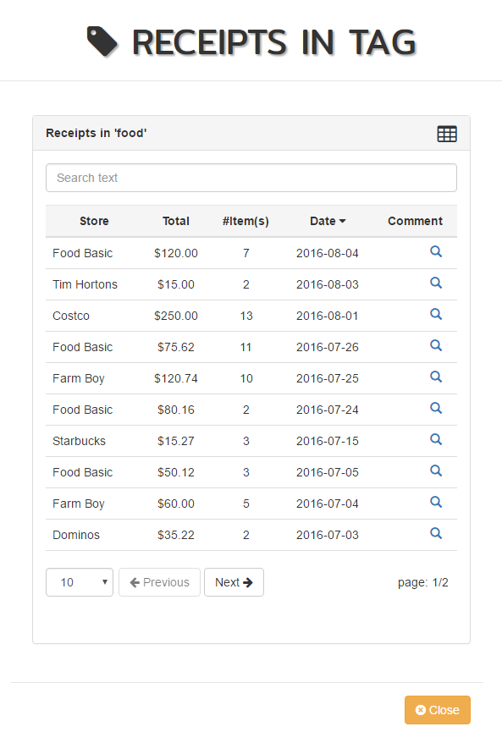
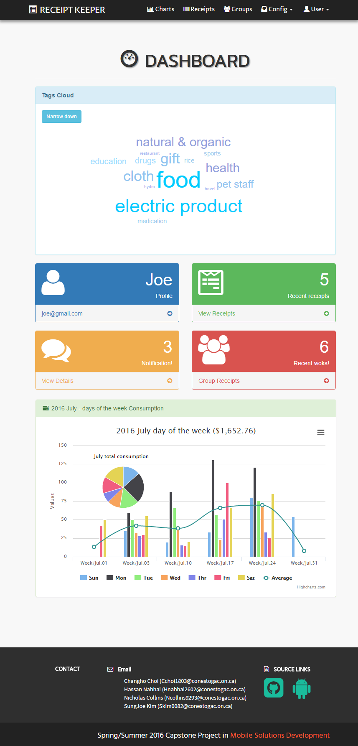
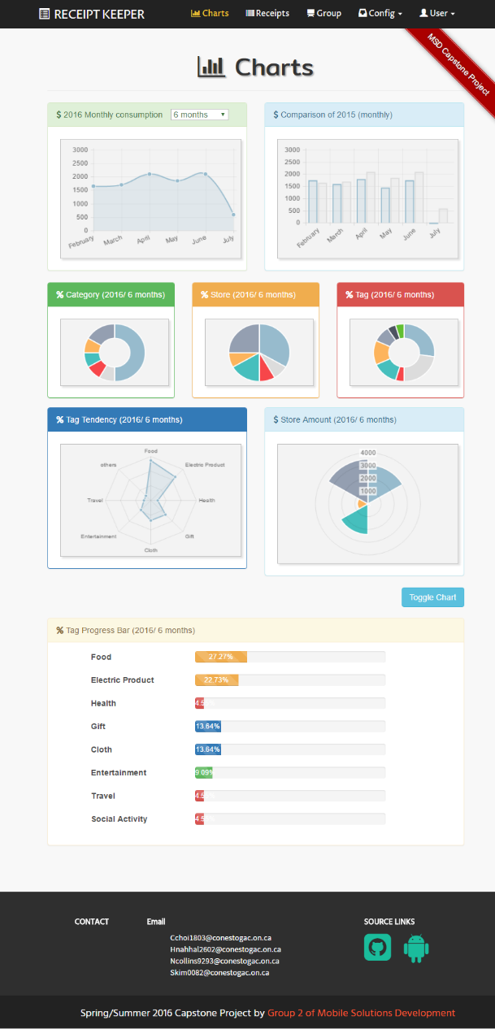
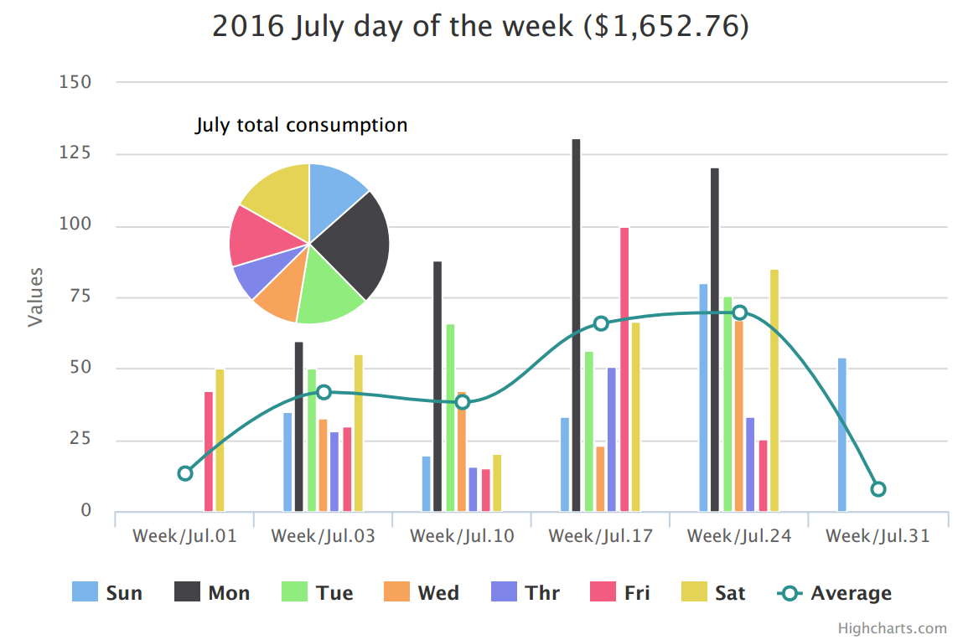
Features (screenshots)

Slide 18
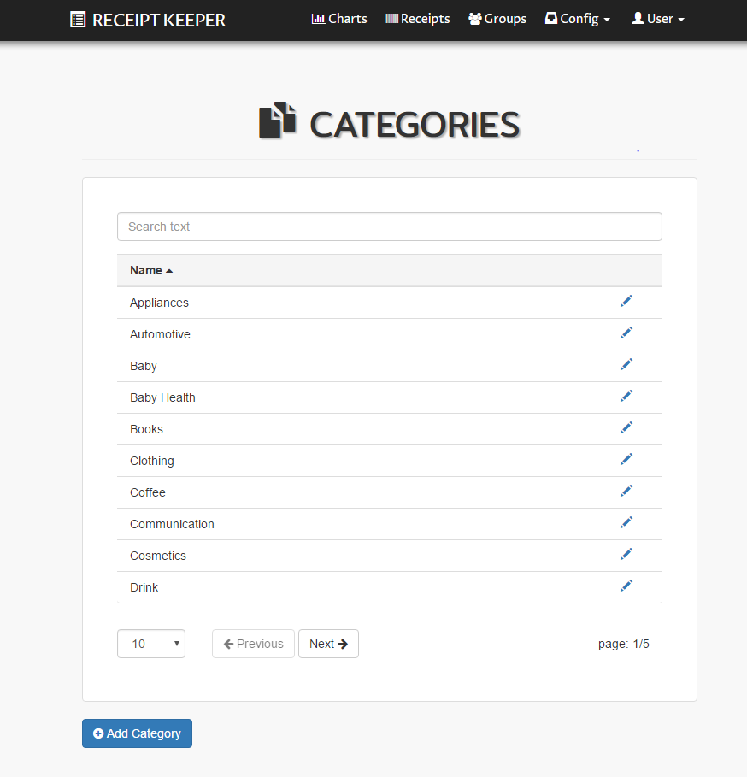
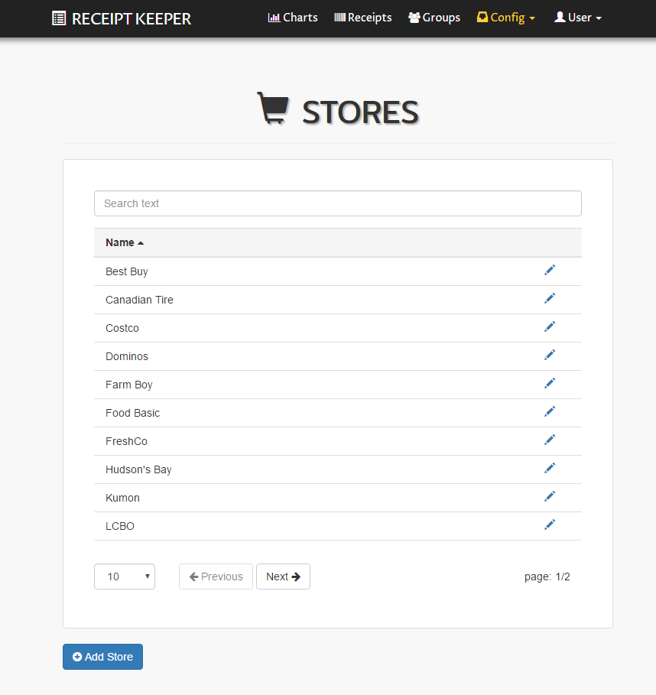
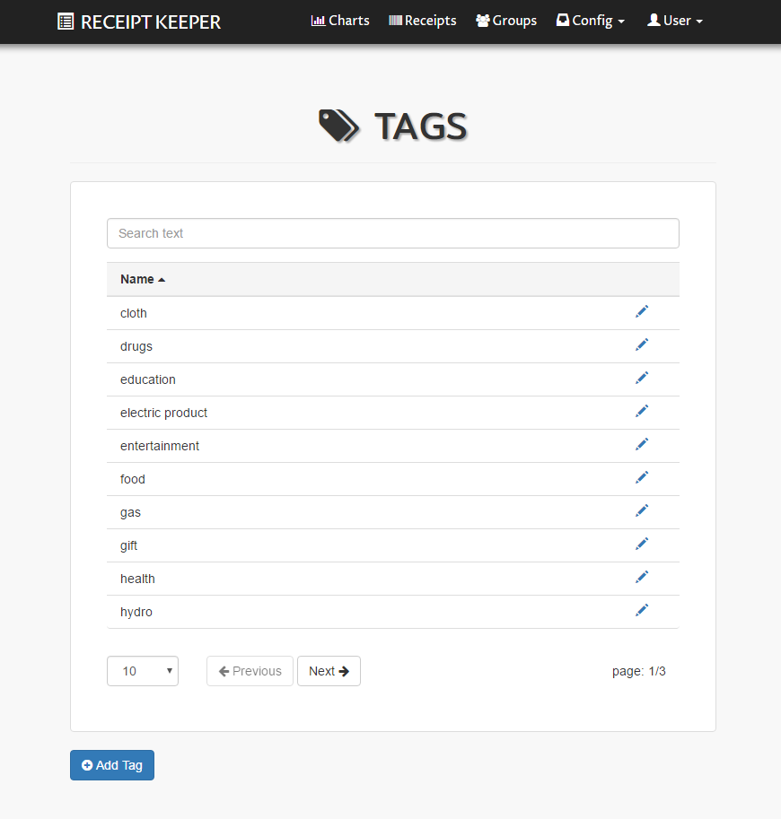

Features (screenshots)
User defined data structure
Category/ Store/ Tag
Track using data

Slide 19
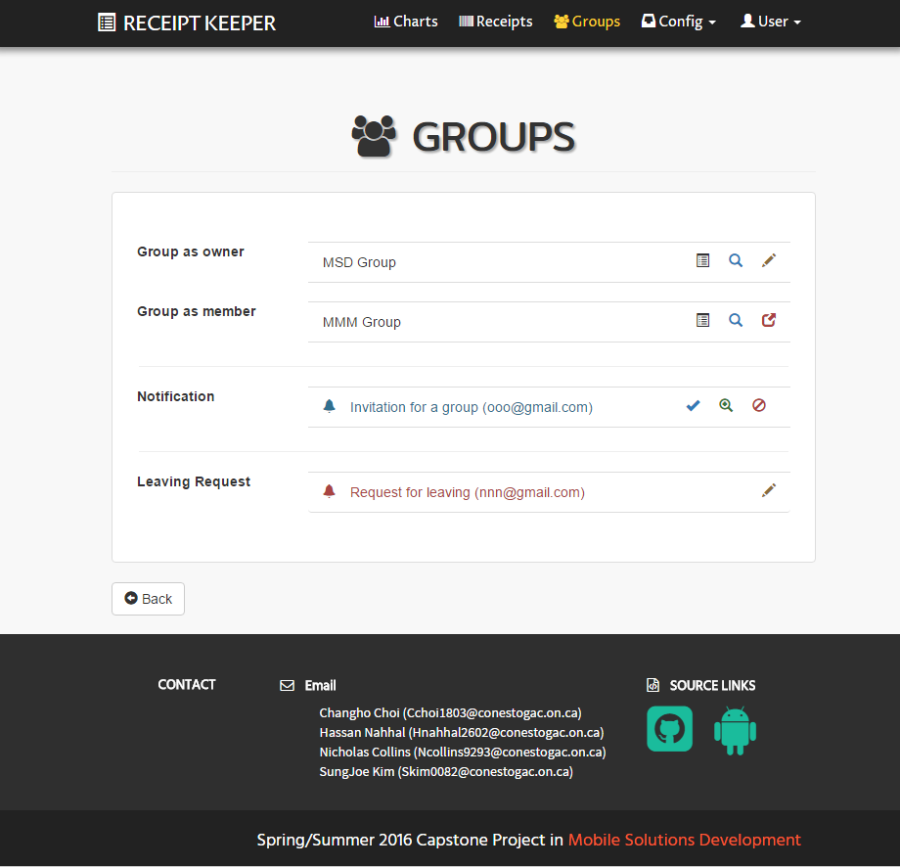
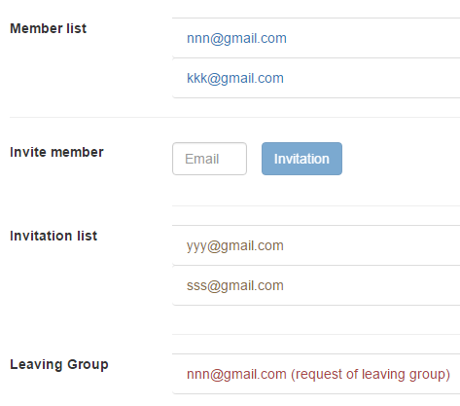

Features (screenshots)
Create group
Works in group
Invite member
Store & Share

Slide 20

Future Plans
Save daily paperless receipts
Imp./Exp. with various formats
Switch between account type
Combine multiple images
OpenCV to improve accuracy
Track each member in group
Retrieve from specific item(s)
Notes:
Here, again Nick

Slide 21

Conclusion
Scan receipts with mobile devices
Save data local or online
Track spending
View and export reports as files
Provide various visual information
Access anywhere/ anytime
Support works in group

Slide 22





Team members
Changho Choi
Mobile UI/ Web Sync.
Hassan Nahhal
Mobile UI/ Back-End
Nicholas Collins
OCR/ Mobile Front-End
SungJoe Kim
Web UI/ Front/ Back-End
Notes:
Move this slide when Q&A sections

Slide 23
Thank you
for
your attention!
Receipt Keeper

Slide 24
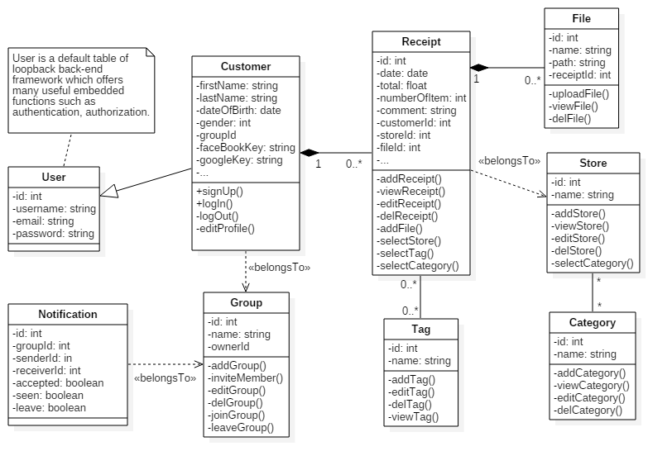
Diagrams (Details)
Back

Slide 25
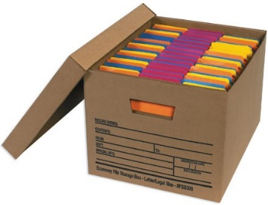
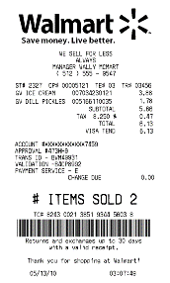
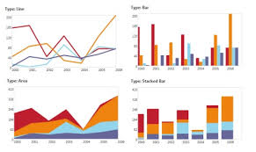
What’s it?
Receipt Keeper
Manage Receipts easier
Start it with mobile devices
Track what you’ve spent
Anytime & Anywhere
Store & Share Online

Slide 26
Methodologies
Android mobile client (SQLite/Tesseract)
TurtleIO web server
Node.js as Back-End
LoopBack framework (REST API)
mongoDB (mLab)
AngularJS, JavaScript, jQuery
HTML5, CSS3, Bootstrap
GitHub, Heroku

Slide 27

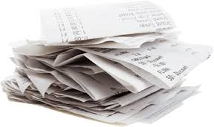


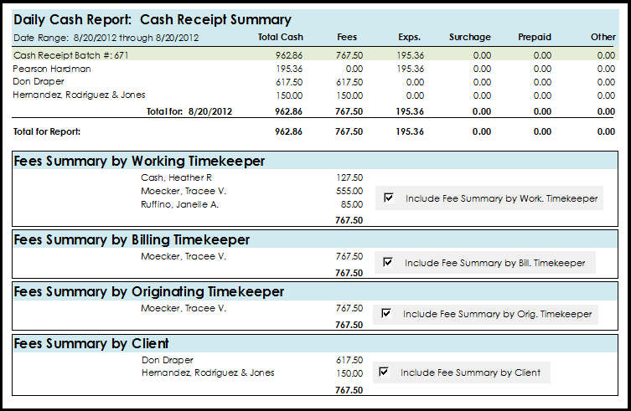

Work Process
view
receipts
scanning
check
export files
anytime/ anywhere
track status

